Slide 1
Communication Diagram

Slide 2
Communication Diagram
Communication diagrams, a kind of interaction diagram, emphasize the data
links between the various participants in the interaction.
UML Communication Diagrams, previously known as collaboration diagrams are a type of behavioral diagram that shows the interactions that take place between objects in a piece of software or system.
This type of diagram emphasizes the messages exchanged between objects. Communication diagrams are best used when one use case has multiple scenarios that need depicting.

Slide 3
Communication & Sequence Diagram
Sequence and Communication diagram shows how objects interact.
It shows objects along with the messages that travel from one object to the another.
Sequence diagram shows the time ordering of interaction
Communication diagram emphasizes the context and overall organization.

Slide 4
Symbols
Rectangles represent objects that make up the application.
Lines between class instances represent the relationships between different parts of the application.
Arrows represent the messages that are sent between objects.
Numbering lets you know in what order the messages are sent and how many messages are required to finish a process.

Slide 5
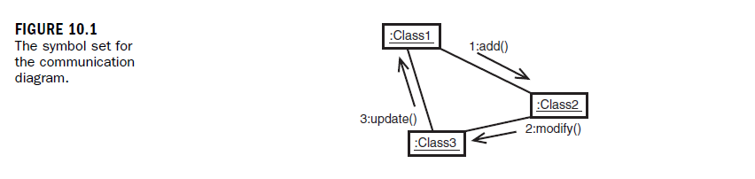

Slide 6
Object and Communication Diagram
Object Diagram shows objects and their relationships with one another.
Communication Diagram is extension of Object Diagram.
Object Diagram is like a snapshot and Communication is like a movie.
Object Diagram shows instances and their linkage.
Communication shows the message among instances over the time.

Slide 7
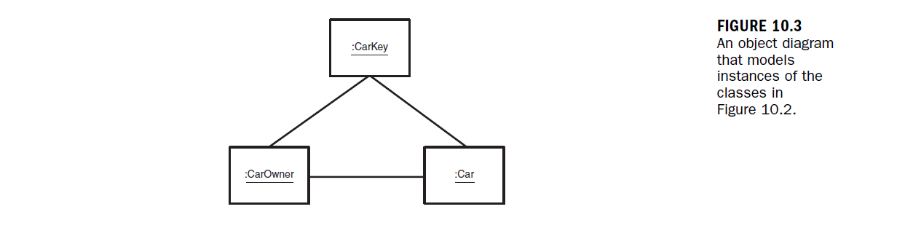
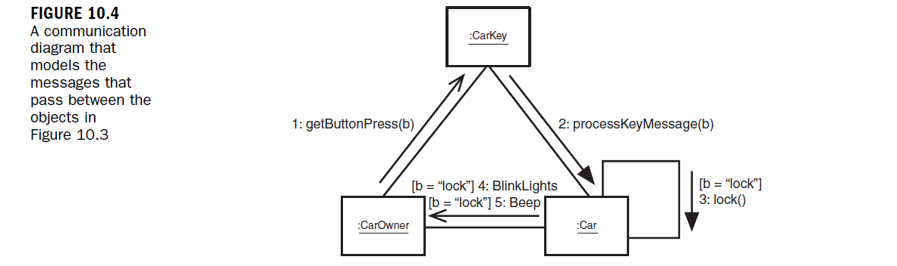
Object & Communication Diagram

Slide 8
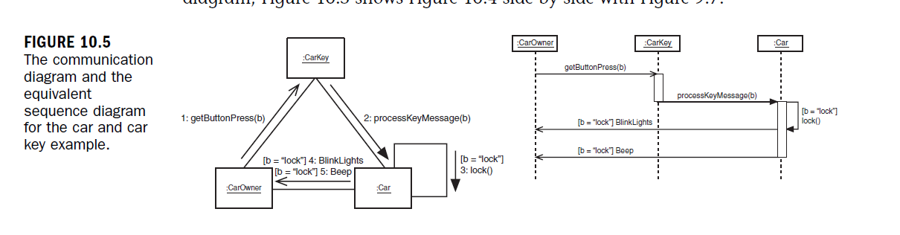
Communication & Sequence are semantically Equivalent:

Slide 9
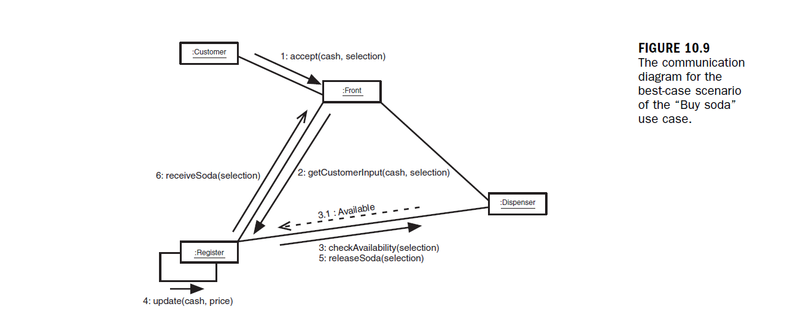
Communication Diagram Example:

Slide 10
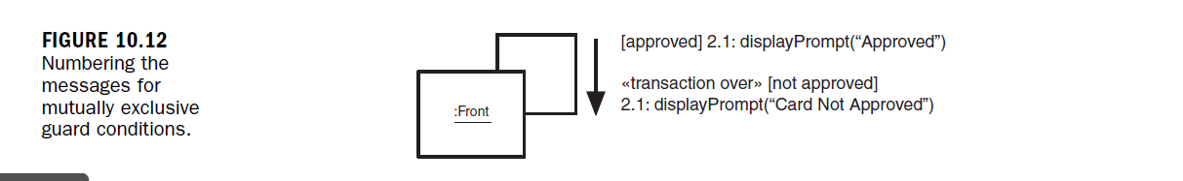
Numbering the messages

Slide 11
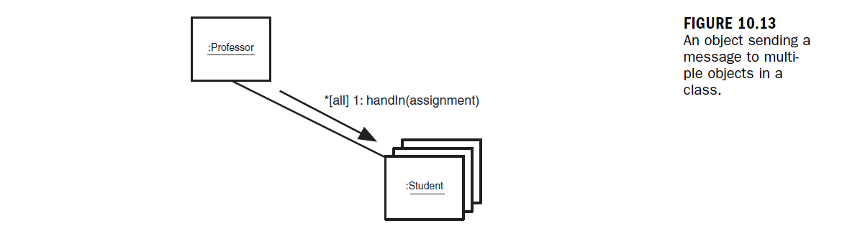
Multiple Receiving Objects
Sometimes an object send message to multiple objects

Slide 12
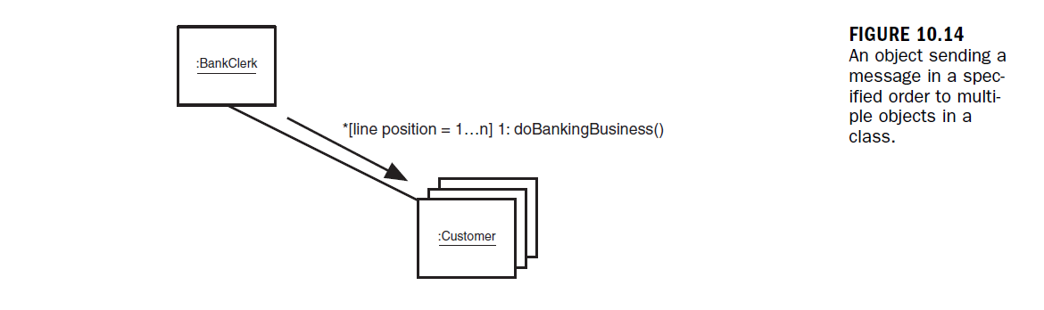
Order of message for multiple Objects
Order of message is important
For Example: A bank serves each customer in the order they appear in line.

Slide 13
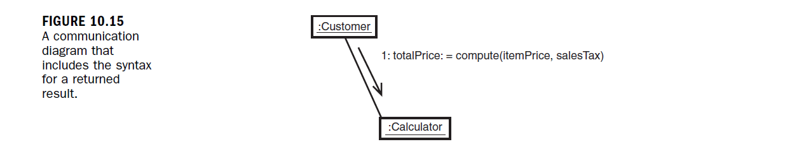
A message can be request for an object to perform calculation and return a value

Slide 14
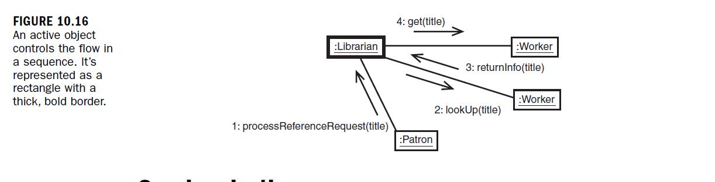
Active Objects
Active Objects can send message to passive objects and interact with other active objects

Slide 15
